Slide 1



HR DATA ANALYSIS
PSYLIQ Internship Project
Created by: Divya Pardeshi

Slide 2



INTRODUCTION
In this presentation, I’ve explored key HR questions within a dataset of over 4,400 employees, addressing a range of topics. I will demonstrate my approach to solving the HR Data Analysis Assessment tasks, which include:
Filtering datasets to display specific employee groups
Creating pivot tables to summarize data
Applying conditional formatting to highlight key metrics
Visualizing trends through charts and graphs
Additionally, I will cover establishing relationships between datasets in Power BI. Each task is designed to showcase practical skills in both Excel and Power BI, with the aim of deriving actionable insights from HR data.

Slide 3


PROJECT QUESTIONS
& Solutions

Slide 4
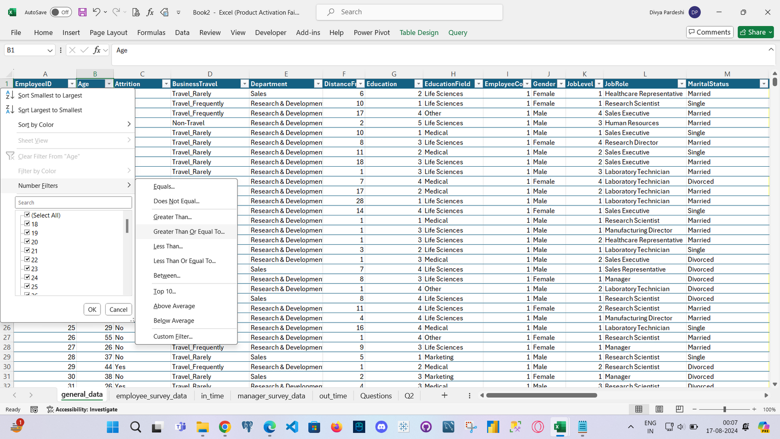
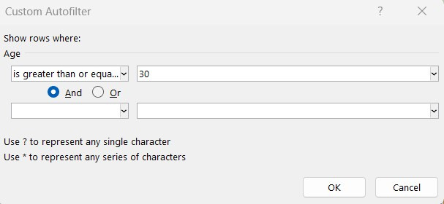

1. USING EXCEL, HOW WOULD YOU FILTER THE DATASET TO ONLY SHOW EMPLOYEES AGED 30 AND ABOVE?

Slide 5
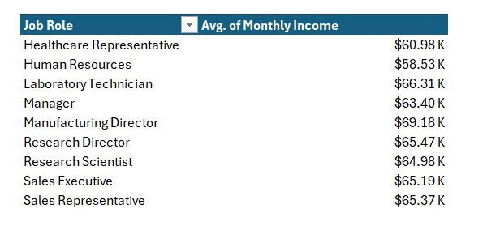

2. CREATE A PIVOT TABLE TO SUMMARIZE THE AVERAGE MONTHLY INCOME BY JOB ROLE.

Slide 6
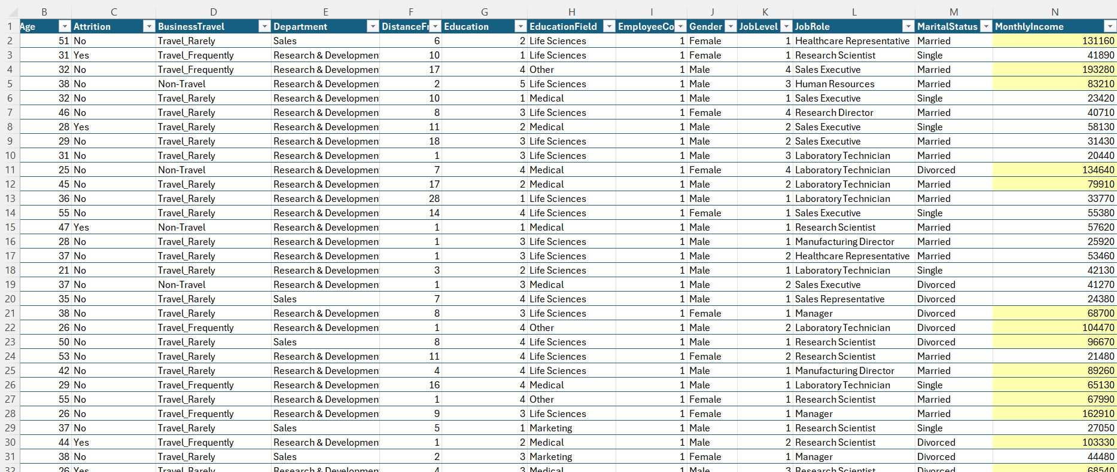

3. APPLY CONDITIONAL FORMATTING TO HIGHLIGHT EMPLOYEES WITH MONTHLY INCOME ABOVE THE COMPANY'S AVERAGE INCOME

Slide 7
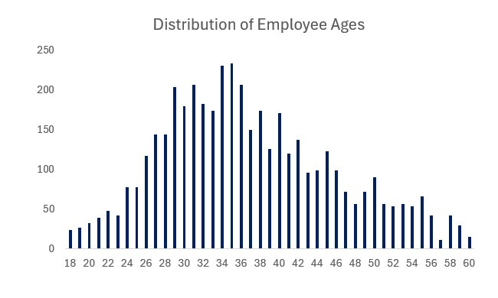

4. CREATE A BAR CHART IN EXCEL TO VISUALIZE THE DISTRIBUTION OF EMPLOYEE AGES.

Slide 8
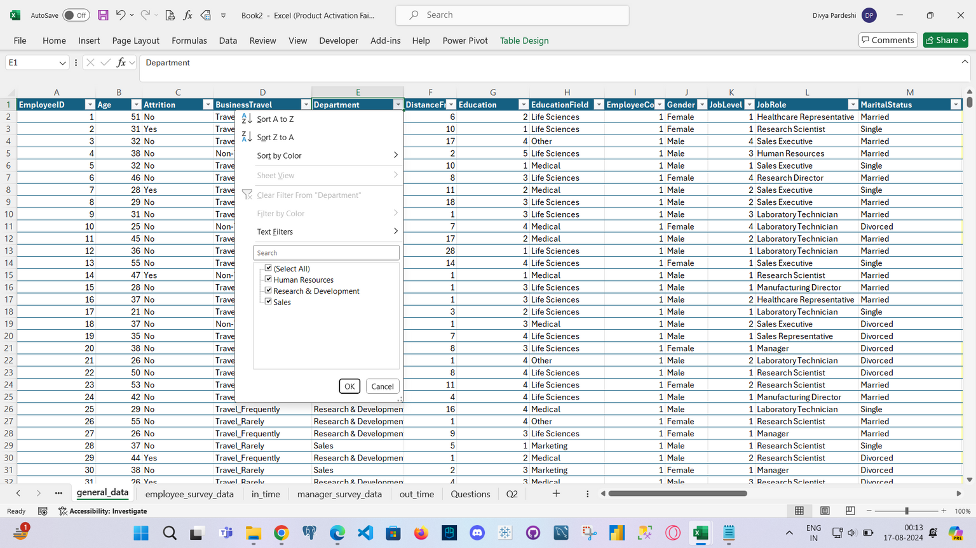

5. IDENTIFY AND CLEAN ANY MISSING OR INCONSISTENT DATA IN THE "DEPARTMENT" COLUMN.
NO INCONSISTENT DATA

Slide 9
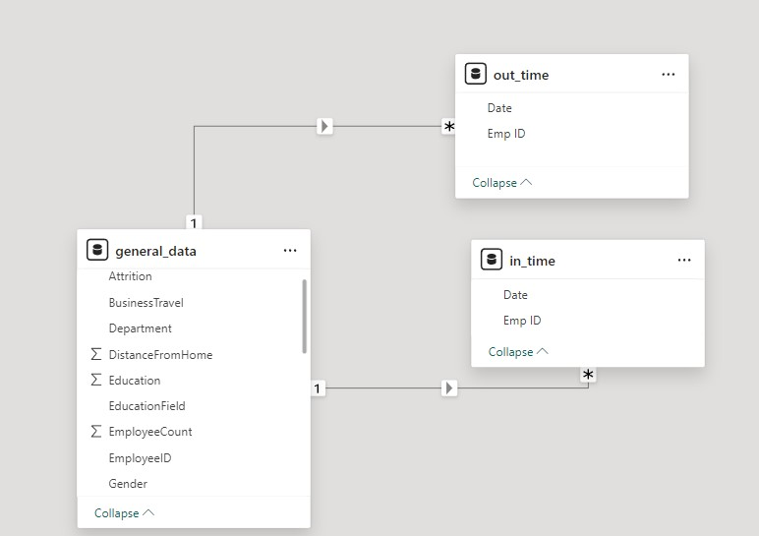

6. IN POWER BI, ESTABLISH A RELATIONSHIP BETWEEN THE "EMPLOYEEID" IN THE EMPLOYEE DATA AND THE "EMPLOYEEID" IN THE TIME TRACKING DATA.

Slide 10

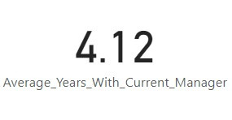
7. USING DAX, CREATE A CALCULATED COLUMN THAT CALCULATES THE AVERAGE YEARS AN EMPLOYEE HAS SPENT WITH THEIR CURRENT MANAGER.

Slide 11
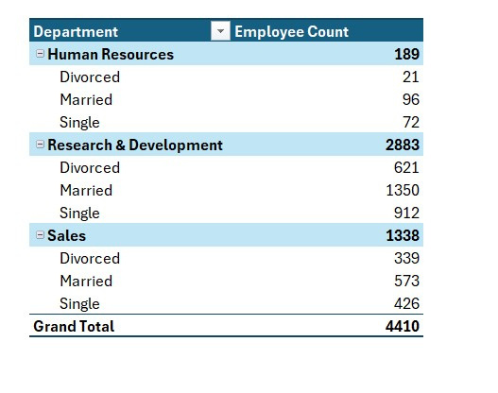

8. USING EXCEL, CREATE A PIVOT TABLE THAT DISPLAYS THE COUNT OF EMPLOYEES IN EACH MARITAL STATUS CATEGORY, SEGMENTED BY DEPARTMENT.

Slide 12
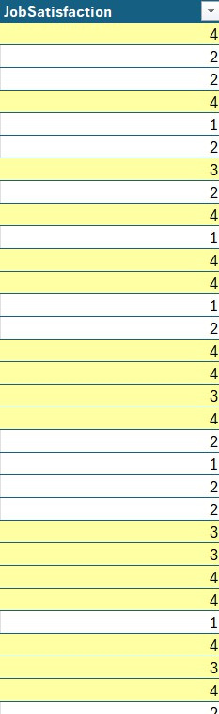

9. APPLY CONDITIONAL FORMATTING TO HIGHLIGHT EMPLOYEES WITH BOTH ABOVE-AVERAGE MONTHLY INCOME AND ABOVE-AVERAGE JOB SATISFACTION.

Slide 13
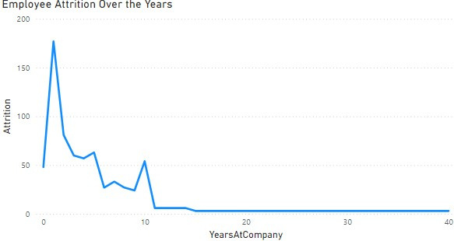
10.IN POWER BI, CREATE A LINE CHART THAT VISUALIZES THE TREND OF EMPLOYEE ATTRITION OVER THE YEARS.

Slide 14
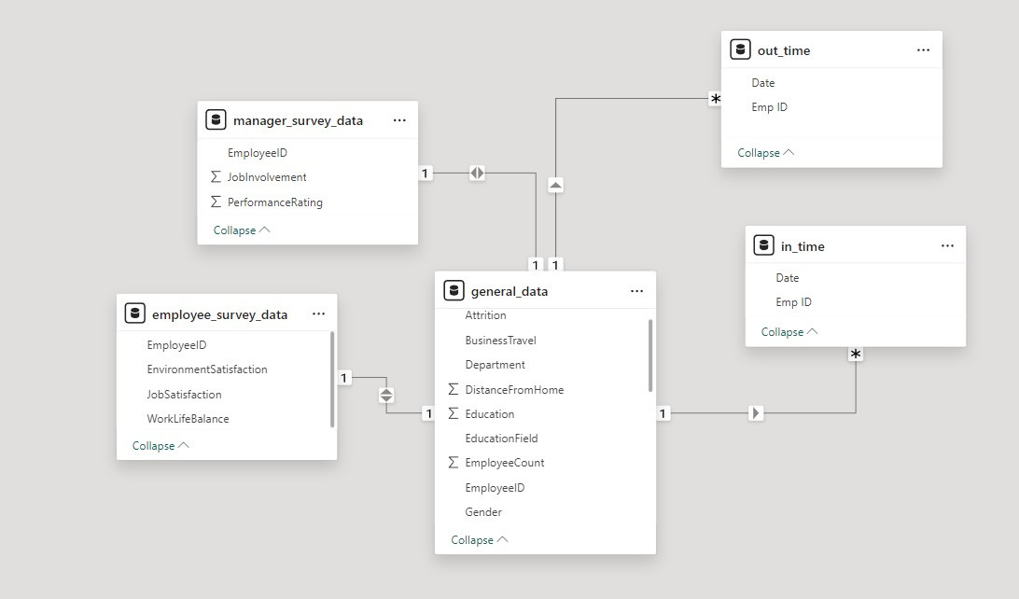
11. DESCRIBE HOW YOU WOULD CREATE A STAR SCHEMA FOR THIS DATASET, EXPLAINING THE BENEFITS OF DOING SO.
Optimized Query Performance: Power BI's VertiPaq engine is highly optimized for star schemas, leading to faster data processing and report generation.
Simplified Data Model: A clear separation between fact and dimension tables makes the data model easier to understand, maintain, and visualize within Power BI.
Efficient DAX Calculations: DAX formulas work more efficiently with star schemas, especially for measures that involve complex aggregations or filtering across dimensions.
Improved Data Refresh: Star schemas often result in smaller, more focused tables, which can lead to quicker data refresh times and more efficient memory usage in Power BI.
Better Visualization Performance: The structured data model allows Power BI to generate visuals more quickly, improving the overall responsiveness of dashboards and reports.

Slide 15
12. USING DAX, CALCULATE THE ROLLING 3-MONTH AVERAGE OF MONTHLY INCOME FOR EACH EMPLOYEE.
Rolling Avg = CALCULATE(Average
(‘generaldata’[MonthlyIncome]),DATESINPERIOD(‘dimdate’[Date],
LASTDATE(‘dimdate’[Date]),-3,Month))

Slide 16
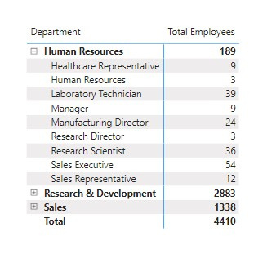
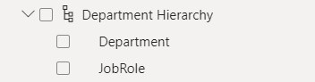
13. CREATE A HIERARCHY IN POWER BI THAT ALLOWS USERS TO DRILL DOWN FROM DEPARTMENT TO JOB ROLE TO FURTHER NARROW THEIR ANALYSIS.

Slide 17
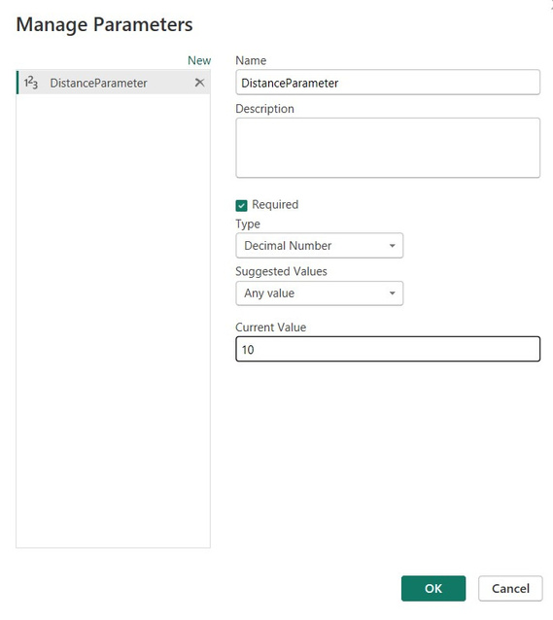
14. HOW CAN YOU SET UP PARAMETERIZED QUERIES IN POWER BI TO ALLOW USERS TO FILTER DATA BASED ON THE DISTANCE FROM HOME COLUMN?
To set up parameterized queries in Power BI for filtering data based on the "Distance from Home" column:
1. Click on "Transform data" to open Power Query Editor.
2. In Power Query Editor, click on "Manage Parameters" in the "Home" tab.
3. Create a new parameter, for example, "DistanceParameter," and set its data type (like Decimal or Whole Number).
4. Close the "Manage Parameters" window and go back to the data view.
5. In the filter for the "Distance from Home" column, replace a constant value with the created parameter like "is less than or equal to DistanceParameter."
6. Go back to the report view, and you'll see a new parameter in the right pane.
7. Users can now adjust the parameter to filter data based on different distances from home.

Slide 18
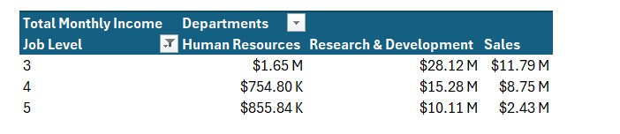
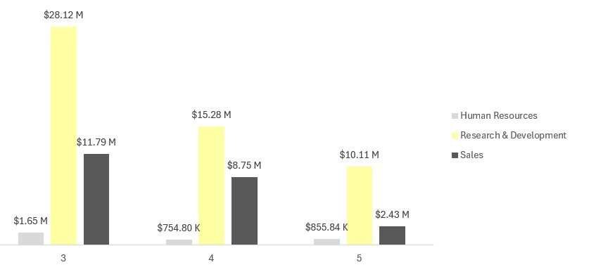
15. IN EXCEL, CALCULATE THE TOTAL MONTHLY INCOME FOR EACH DEPARTMENT, CONSIDERING ONLY THE EMPLOYEES WITH A JOB LEVEL GREATER THAN OR EQUAL TO 3.

Slide 19
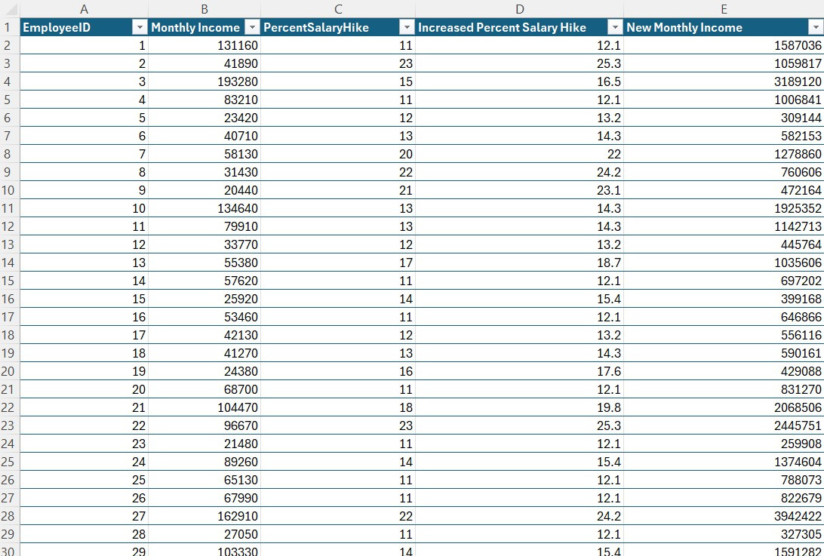
16. EXPLAIN HOW TO PERFORM A WHAT-IF ANALYSIS IN EXCEL TO UNDERSTAND THE IMPACT OF A 10% INCREASE IN PERCENT SALARY HIKE ON MONTHLY INCOME.

Slide 20
17. VERIFY IF THE DATA ADHERES TO A PREDEFINED SCHEMA. WHAT ACTIONS WOULD YOU TAKE IF YOU FIND INCONSISTENCIES.
To verify if the data adheres to a predefined schema and handle inconsistencies, follow these steps:
1. Define the Schema:
Clearly outline the expected structure of data, including data types, allowed categorical values, and any constraints.
2. Load the Data:
Import the data into analysis environment, such as Excel, Power BI, or a database management system, ensuring it's loaded according to the predefined schema.
3. Check Data Types and Missing Values:
Data Types: Ensure each column's data type matches the predefined schema (e.g., numeric, text, date).
Missing Values: Identify and evaluate any missing values to determine if they are acceptable or need to be addressed.
4. Validate Categorical Data:
Cross-check categorical columns against the list of predefined valid categories. Ensure no unexpected or invalid values are present.

Slide 21
17. VERIFY IF THE DATA ADHERES TO A PREDEFINED SCHEMA. WHAT ACTIONS WOULD YOU TAKE IF YOU FIND INCONSISTENCIES.
Handling Inconsistencies:
Incorrect Data Types:
Action: Convert the data to the correct type, or flag and correct any records that cannot be converted.
Missing Values:
Action: Handle missing data by either imputing values, removing the affected records, or flagging them for further investigation, depending on the context.
Invalid Categorical Values:
Action: Correct or remove any records with invalid categories, or map them to valid categories if possible.

Slide 22


THANK YOU

